Slide 1

16. IP Address v4
www.cognixia.cm

Slide 2
What is IP Address?
An IP address is a 32-bit number or 4 Octet number which uniquely identifies a host or network node over a TCP/IP network.
IP addresses are normally expressed in dotted-decimal format In which 4 Octet are separated by dots.
For Example: 192.168.123.132.

Slide 3
Subnet mask
Subnet mask also is 32 bit number, every IP address has its own subnet mask. Subnet mask helps to identify, how many bits out of 32 belongs to network and how many bits belong to host.
This way, the subnet mask is used by the TCP/IP protocol to determine whether a host is on the local subnet or on a remote network.
IPv4 are divided into 5 classes such as Class A, B, C, D and E
Class A, B and C are used for commercial purposes.

Slide 4
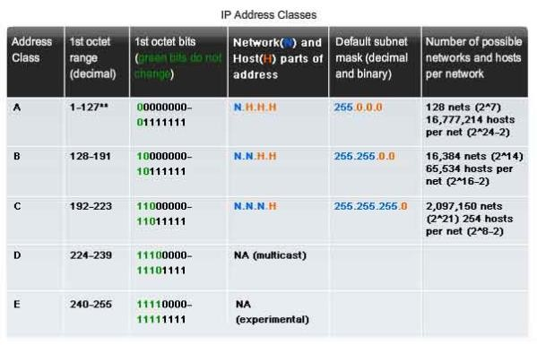
IPv4 Address Table

Slide 5
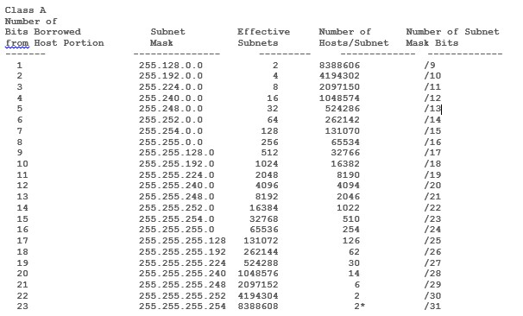
Class A Host/Subnet Table

Slide 6
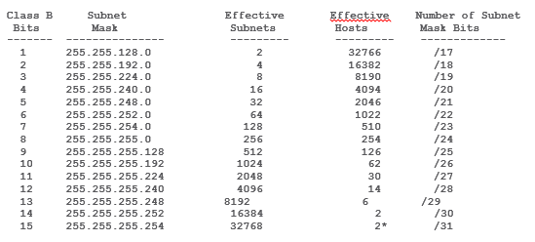
Class B Host/Subnet Table

Slide 7
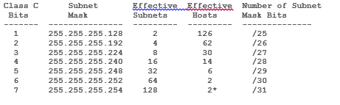
Class C Host/Subnet Table

Slide 8
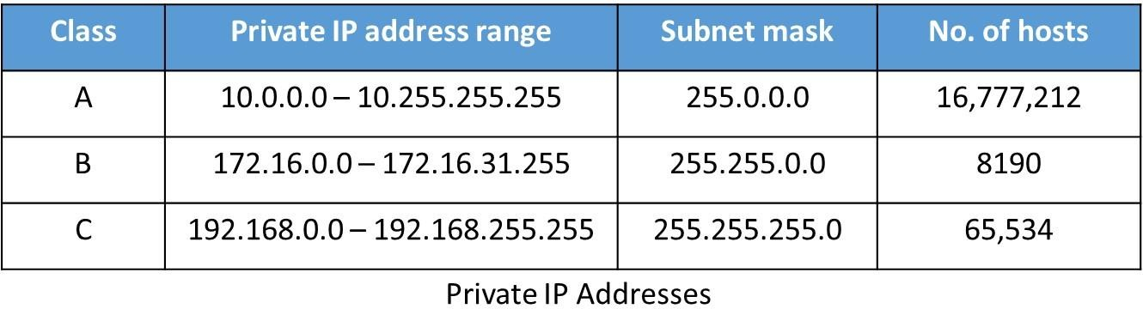
Private IP Addresses
A private IP address is an IP address that's reserved for internal use behind a router or other Network Address Translation (NAT) devices, apart from the public.
Public IP addresses are allocated to Internet faced routers and Servers, which can be able to access internet directly.
The Internet Assigned Numbers Authority (IANA) reserves the following IP address
blocks for use as private IP addresses:

Slide 9
Reserved IP addresses:
Loopback Addresses
The IP address range 127.0.0.0 – 127.255.255.255 is reserved for loopback, i.e. a Host’s self-address, also known as localhost address.
Loopback addresses, enable the Server and Client processes on a single system to communicate
Link-Local Addresses
In case a host is not able to acquire an IP address from the DHCP server and it has not been assigned any IP address manually, the host can assign itself an IP address from a range of reserved Link-local addresses. Link local address ranges from 169.254.0.0 -- 169.254.255.255.

Slide 10
CIDR (Classless Inter-Domain Routing)
This is a way to allow more flexible allocation of IP addresses than was possible with the original system of IP address classes. As a result, the number of available Internet addresses now increased, which along with widespread use of network address translation (NAT), has significantly extended the useful life of IPv4.
10.10.10.0/24 By default 10.X.X.X range belongs to class A with /8 notation But here, you see, we can use /24 notation instead of /8
For Example:

